Slide 2
Acknowledgement
of Country
[ We acknowledge the Traditional Owners of Country throughout Australia and recognises their continuing connection to lands, waters, and communities.
We pay our respect to the people, the cultures, and Elders past and present. ]

Slide 3
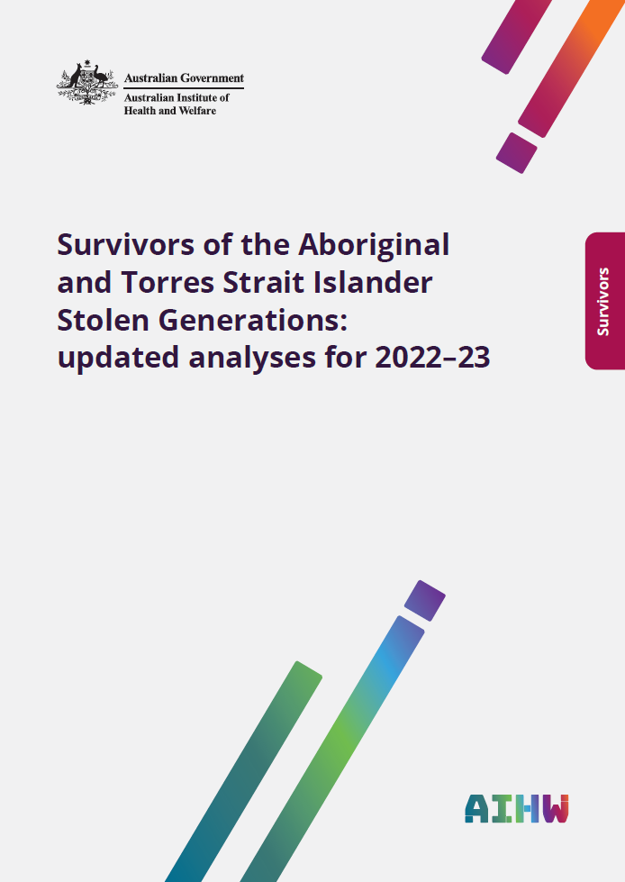
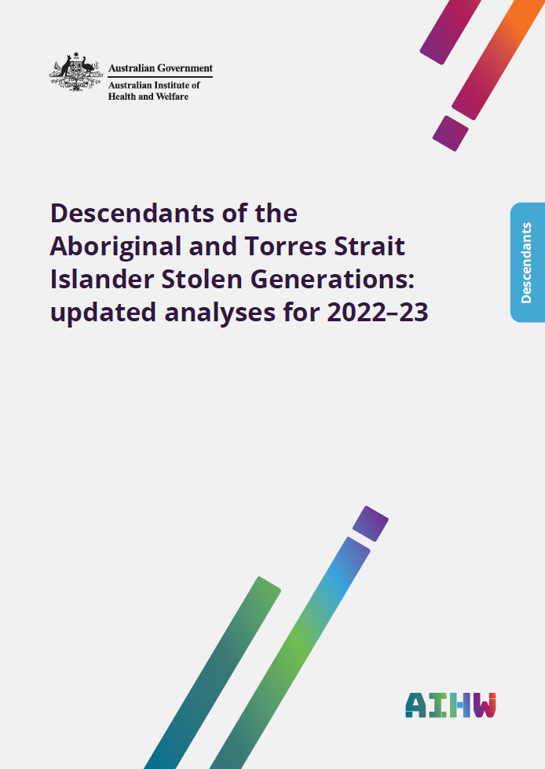
About this project
Commissioned by The Healing Foundation
Latest in a series of studies produced by the Australian Institute of Health and Welfare (AIHW 2026)
Uses 2022–23 national survey data
Covers survivors, descendants, demographic estimates and selected outcomes
Web report: AIHW (Australian Institute of Health and Welfare) (2026) Aboriginal and Torres Strait Islander Stolen Generations survivors and descendants: updated analyses for 2022–‍23, Australian Government.

Slide 4
Which surveys were used
Main data are from the 2022–23 National Aboriginal and Torres Strait Islander Health Survey (NATSIHS)
This survey asked adults to answer these questions, voluntarily:
  Have you been removed from your family by welfare or the government or taken away to a mission?
  Have any of your relatives been removed from their family by welfare or the government or taken away to a mission?
  Are you able to tell me which of your relatives have been removed or taken away from their family?
Data for comparisons with the non-Indigenous population are from the 2022 National Health Survey (NHS)

Slide 5
Populations in this analysis
Stolen Generations survivors
People who self-reported that they were removed from their families and who were aged 50 and over in 2022–23 (born before 1972).
Comparison groups:
Indigenous Australians aged 50 and over who were not removed from their families (self-reported).
Non-Indigenous people aged 50 and over.
Stolen Generations descendants
People who self-reported that at least one parent, (great) grandparent, aunt or uncle was removed from their families.
Comparison groups:
Indigenous people aged 18 and over who self-reported that none of their relatives from previous generations were removed.
Non-Indigenous people aged 18 and over.
Some people are both survivors and descendants of Stolen Generations.
Notes:
Note: 1972 is when legislation and related policies of child removal were largely repealed, although removals are commonly described as extending into the 1970s in some places.
On overlap: Just over half of survivors (around 1 in 2) are also counted as descendants, while a much smaller share of descendants (around 1 in 16) are also counted as survivors

Slide 6
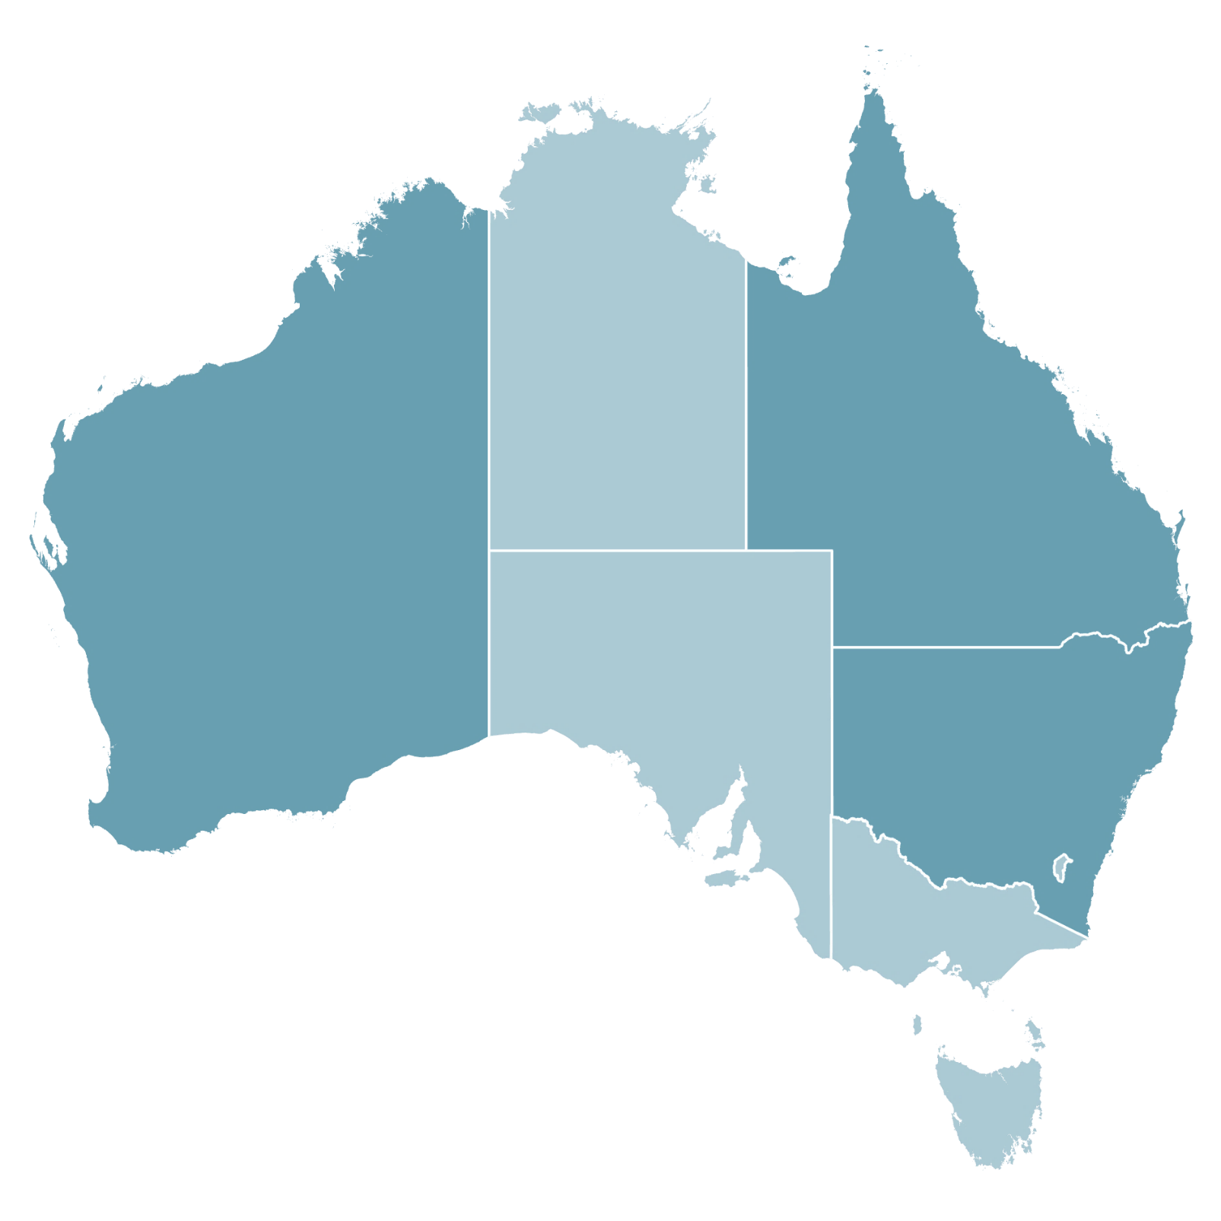
Survivors at a glance
An estimated
23,300
people aged 50 and over had been removed from their family
15% of people aged 50 and over
53%
are women
12,300 people
1,500
6.5%
5,300
23%
5,400
23%
1,800
7.9%
6,600
28%
NSW/ACT
70%
86%
currently live in
non-remote areas
20,000 people
Age distribution
74%
currently live in
NSW/ACT, QLD and WA
1,700
7.3%
30%
70%
960
4.1%
aged 50–64 years
16,300 people
aged 65 and over
7,000 people

Slide 7
Descendants at a glance
An estimated
200,000
people aged 18 and over had family members from elder generations who had been removed
45% of people aged 18 and over
54%
are women
108,000 people
13,400
6.7%
61,400
31%
31,700
16%
13,500
6.8%
59,000
29%
NSW/ACT
70%
89%
currently live in
non-remote areas
177,000 people
Age distribution
76%
currently live in
NSW/ACT, QLD and WA
17,000
8.5%
27%
73%
4,100
2.0%
aged 18–49 years
145,000 people
aged 50 and over
55,000 people

Slide 8
Why population estimates may be higher
The survey may underestimate how many people are survivors or descendants, as some respondents did not or could not answer the questions about experiences of removal, and other people live in facilities/dwellings that are outside the scope of the survey.
If we assume that the proportion who are survivors or descendants from the survey is also true of the remainder of the population, this suggests higher total estimates.
Population group | Survey-based estimate | Accounting for people who may not be included*
Survivors (aged 50+) | 23,300 | 27,300 ▲17%
Descendants (aged 18+) | 200,000 | 284,000 ▲42%
* Calculated as the proportion who were survivors or descendants multiplied by the estimated Indigenous population (aged 50+ or aged 18+) on 30 June 2023.
Notes:
Note: populations not in-scope of the survey include long-term residents of non-private dwellings, such as prisons and residential aged care facilities.

Slide 9
How outcomes were measured
Survey responses analysed in the ABS DataLab
Around 40 outcomes were derived across:
  physical health and disability
  mental health
  socioeconomic wellbeing
  health risk factors
  cultural identity and language use measures
Outcomes for survivors and descendants are compared with those of relevant population groups
Comparisons account for differences in age, and where appropriate, sex and remoteness
Results focus on meaningful differences identified in the data

Slide 10
How to read the findings
Rate ratios compare two groups
  A rate ratio of 2 means the outcome was twice as common in one group as in the comparison group.
Emphasis is on overall patterns
  Individual estimates can be uncertain, but similar findings across multiple related outcomes indicate a clear overall pattern.
Differences may reflect many factors
  These findings show existing differences between groups of people without isolating the impact of removal from other factors.
  They do not capture the full impact of removal or exactly how the different circumstances created by removal have contributed to the outcomes we see today.

Slide 11
Survivors: overview
Most outcomes point towards higher need among survivors compared with Indigenous people who were not removed
      Physical health & care needs
      10 of 15 outcomes pointed towards higher need
      Social & emotional wellbeing
      6 of 6 outcomes pointed towards higher need
      Health risk factors
      3 of 4 outcomes pointed towards higher need
      Socioeconomic factors
      7 of 8 outcomes pointed towards higher need
Differences were even larger when survivors were compared with the non-Indigenous population

Slide 12
Survivors: compared with Indigenous people not removed
Compared with other Indigenous Australians aged 50 and over who were not removed
Survivors were more likely to report:
1.7×
admitted to hospital in past year
1.9×
high psychological distress
2.7×
SOCIAL & EMOTIONAL WELLBEING
PHYSICAL HEALTH & CARE NEEDS
severe or profound disability
1.5×
unable to raise $2,000 in an emergency
1.8×
used substances in the last 12 months
PHYSICAL HEALTH & CARE NEEDS
SOCIOECONOMIC FACTORS
HEALTH RISK FACTORS
Rate ratios (×) show how many times more likely survivors were to report these outcomes.
Comparisons adjusted for age, sex and remoteness.
Notes:
Note: Substances here refer to various drugs used for non-medical purposes, including legal and illicit drugs.

Slide 13
Survivors: compared with non-Indigenous people
Compared with non-Indigenous people aged 50–74
Survivors were more likely to report:
4.8×
severe or profound disability
3.9×
high psychological distress
6.0×
SOCIAL & EMOTIONAL WELLBEING
PHYSICAL HEALTH & CARE NEEDS
kidney disease
4.6×
living in overcrowded household
3.4×
current smoking
PHYSICAL HEALTH & CARE NEEDS
SOCIOECONOMIC FACTORS
HEALTH RISK FACTORS
Rate ratios (×) show how many times more likely survivors were to report these outcomes.
Comparisons adjusted for age.

Slide 14
Descendants: overview
Most outcomes point towards higher need among descendants compared with Indigenous people who were not descendants
      Physical health & care needs
      12 of 16 outcomes pointed towards higher need
      Social & emotional wellbeing
      6 of 6 outcomes pointed towards higher need
      Health risk factors
      4 of 5 outcomes pointed towards higher need
      Socioeconomic factors
      2 of 11 outcomes pointed towards higher need
Differences were even larger when descendants were compared with the non-Indigenous population

Slide 15
Descendants: compared with Indigenous non-descendants
Compared with other Indigenous Australians aged 18 and over who were not descendants
Descendants were more likely to report:
1.4×
ear or hearing problems
1.3×
ever diagnosed with a mental health condition
1.9×
SOCIAL & EMOTIONAL WELLBEING
PHYSICAL HEALTH & CARE NEEDS
kidney disease
1.5×
had problem(s) accessing government services
1.2×
had days without money for basic living expenses
PHYSICAL HEALTH & CARE NEEDS
SOCIAL & EMOTIONAL WELLBEING
SOCIOECONOMIC FACTORS
Rate ratios (×) show how many times more likely descendants were to report these outcomes.
Comparisons adjusted for age, sex and remoteness.

Slide 16
Descendants: compared with non-Indigenous people
Compared with non-Indigenous people aged 18–74
Descendants were more likely to report:
2.6×
severe or profound disability
2.5×
high psychological distress
4.5×
SOCIAL & EMOTIONAL WELLBEING
PHYSICAL HEALTH & CARE NEEDS
kidney disease
2.0×
currently not employed (ages 18–64)
3.0×
diabetes
PHYSICAL HEALTH & CARE NEEDS
SOCIOECONOMIC FACTORS
PHYSICAL HEALTH & CARE NEEDS
Rate ratios (×) show how many times more likely descendants were to report these outcomes.
Comparisons adjusted for age.

Slide 17
Key messages
Survivors and descendants make up a substantial share of the Indigenous population
  Around 1 in 7 Indigenous Australians aged 50+ are survivors
  Almost half of Indigenous Australians aged 18+ are descendants
Higher need is evident across multiple areas of health and wellbeing
  Survivors and descendants face greater challenges than other Indigenous Australians of the same age
  Gaps are larger when survivors and descendants are compared with the non-Indigenous population
Maintaining the evidence base could become more challenging as survivors age
  Survivors are an ageing population — nearly 1 in 3 survivors are aged 65 and over
  As survivors grow older, they could become less well represented in household surveys, making it more difficult to understand their circumstances and needs over time
  Data development should be explored to maintain the evidence base

Slide 18
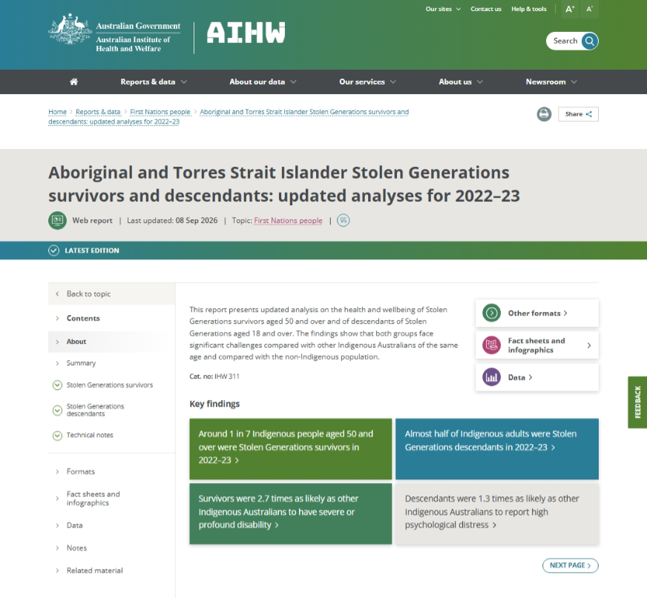
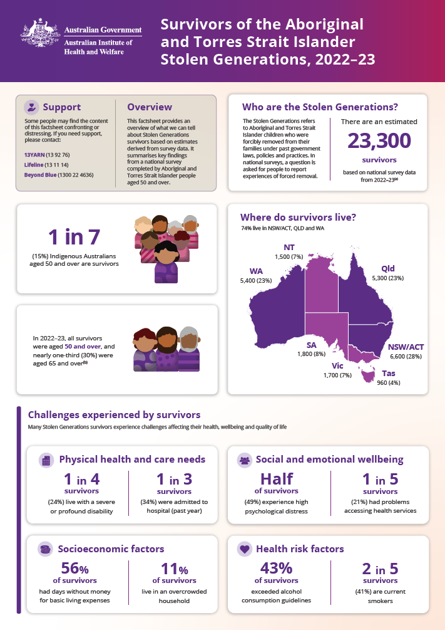
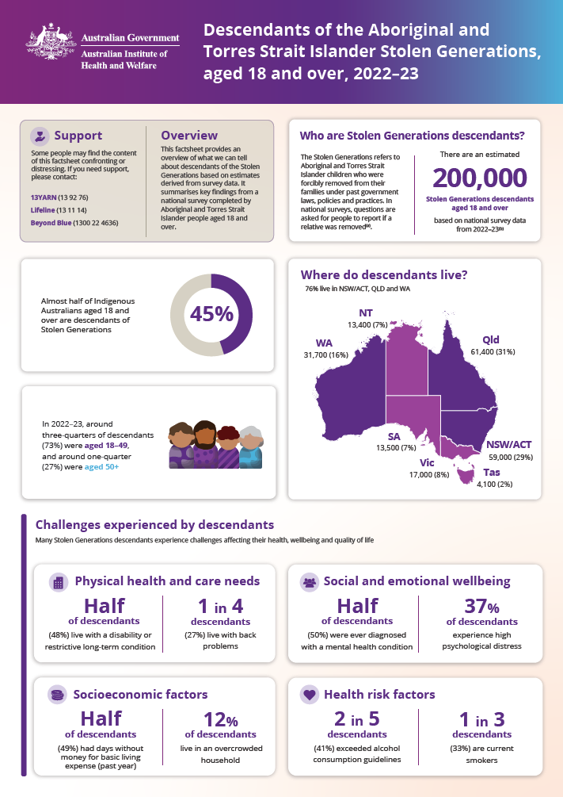
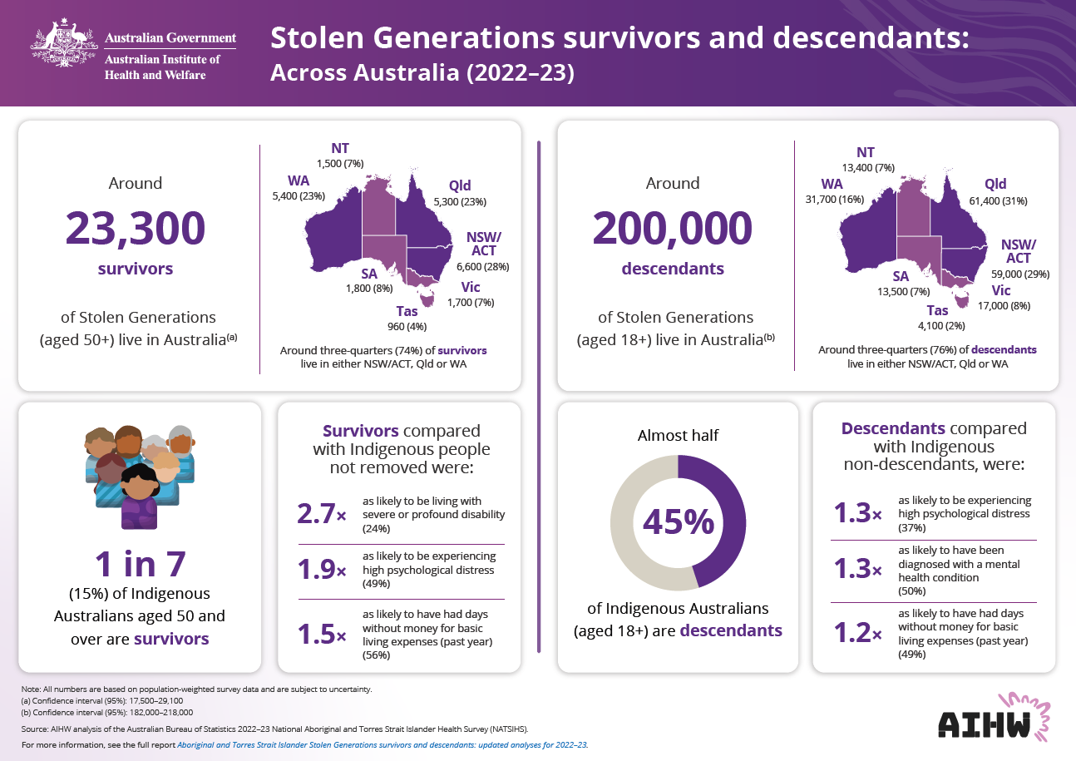
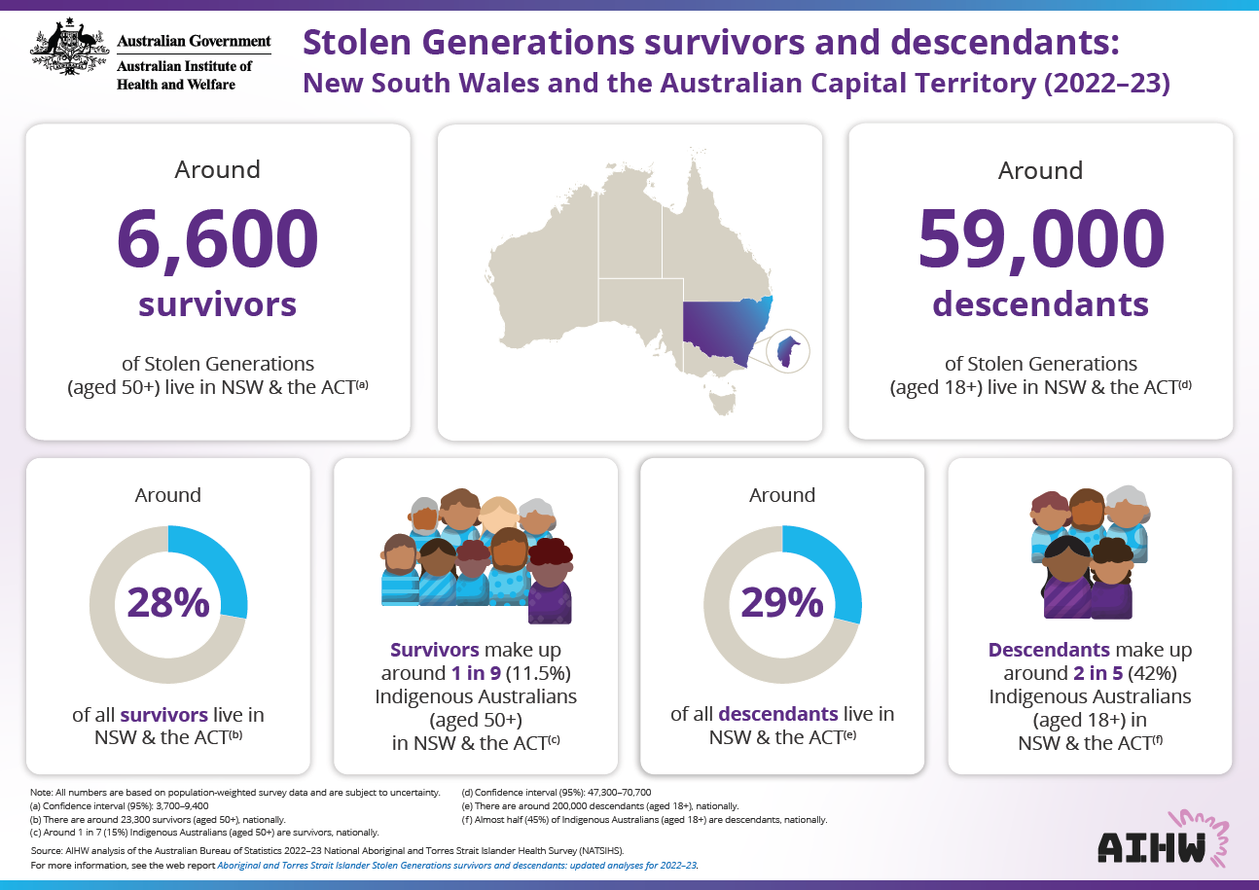
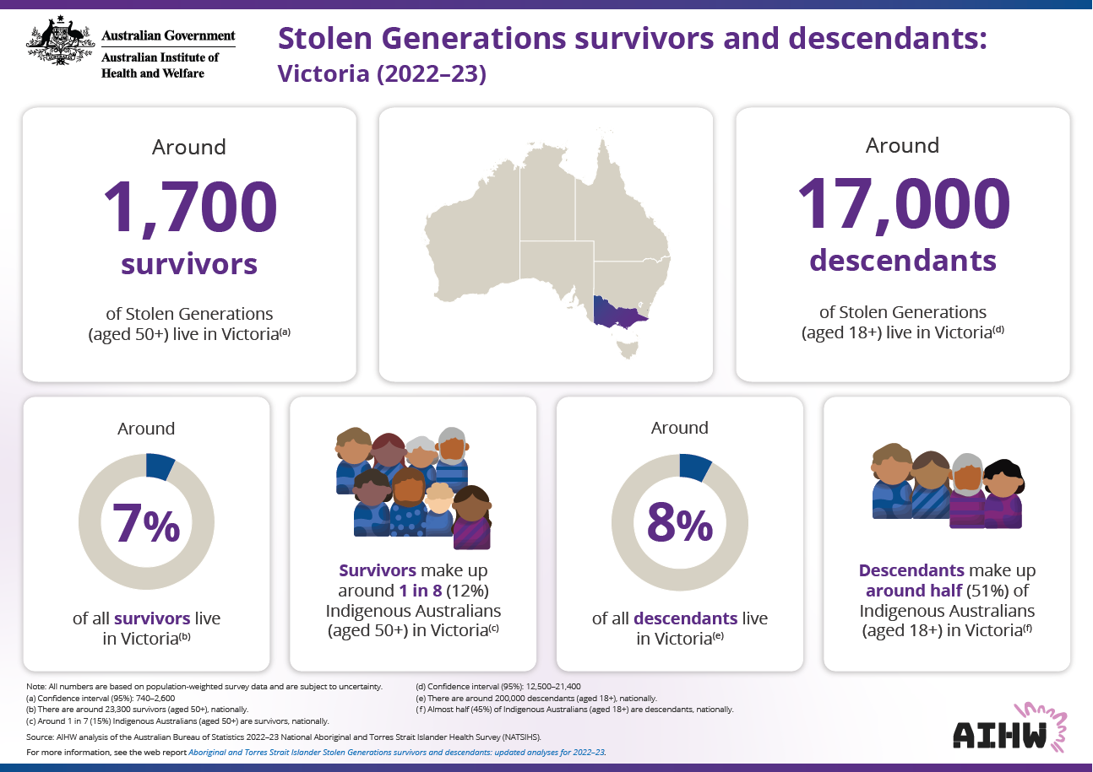
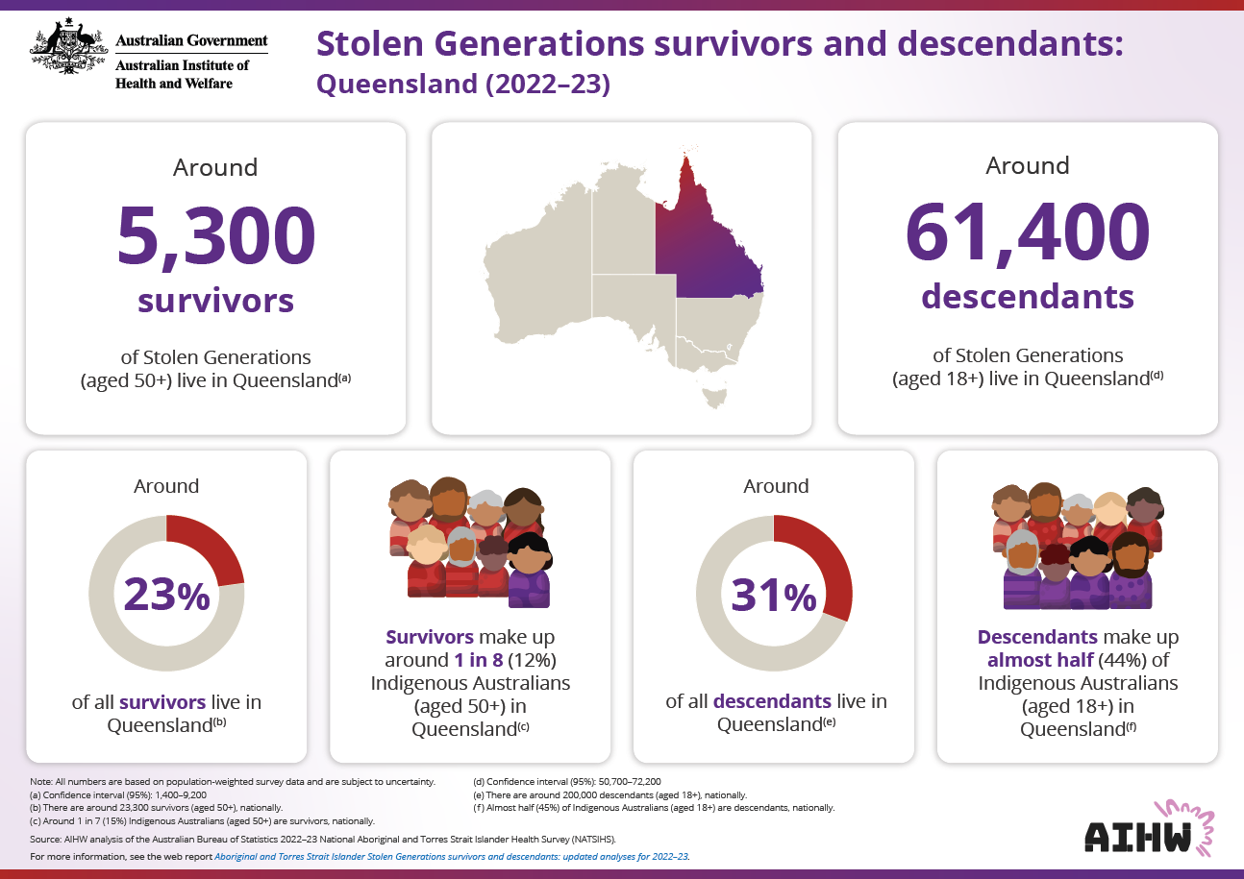
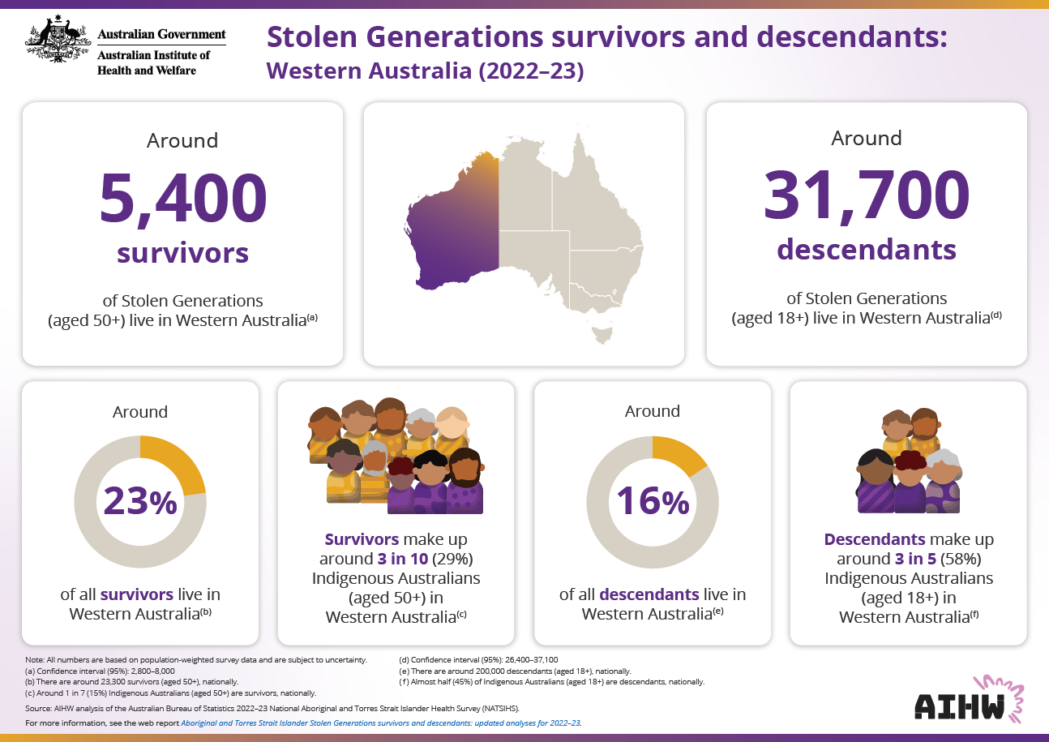
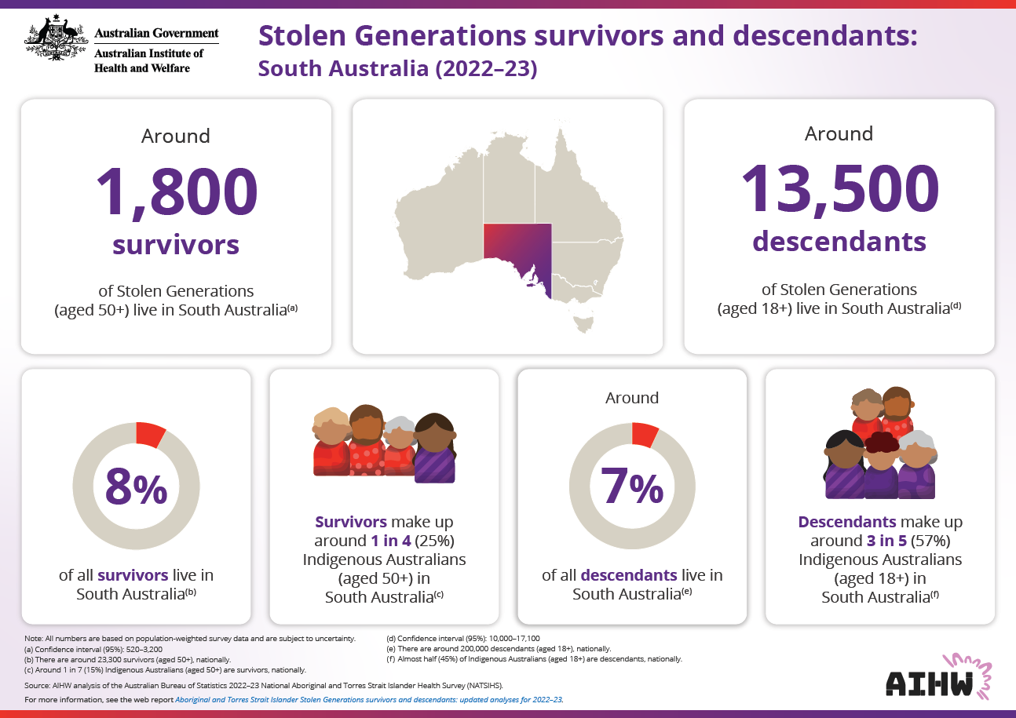
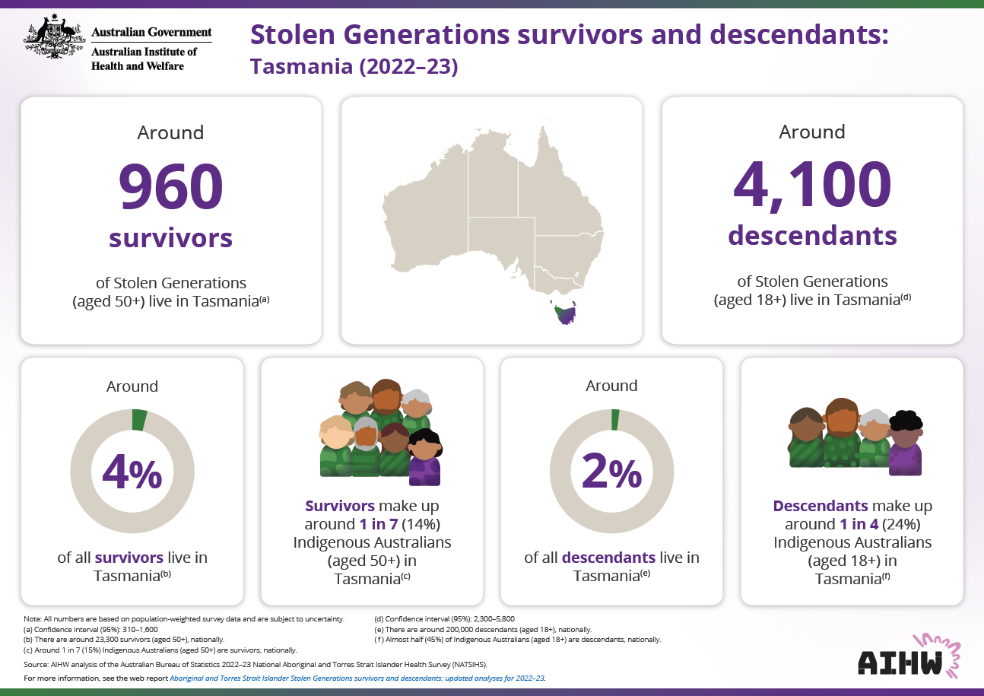
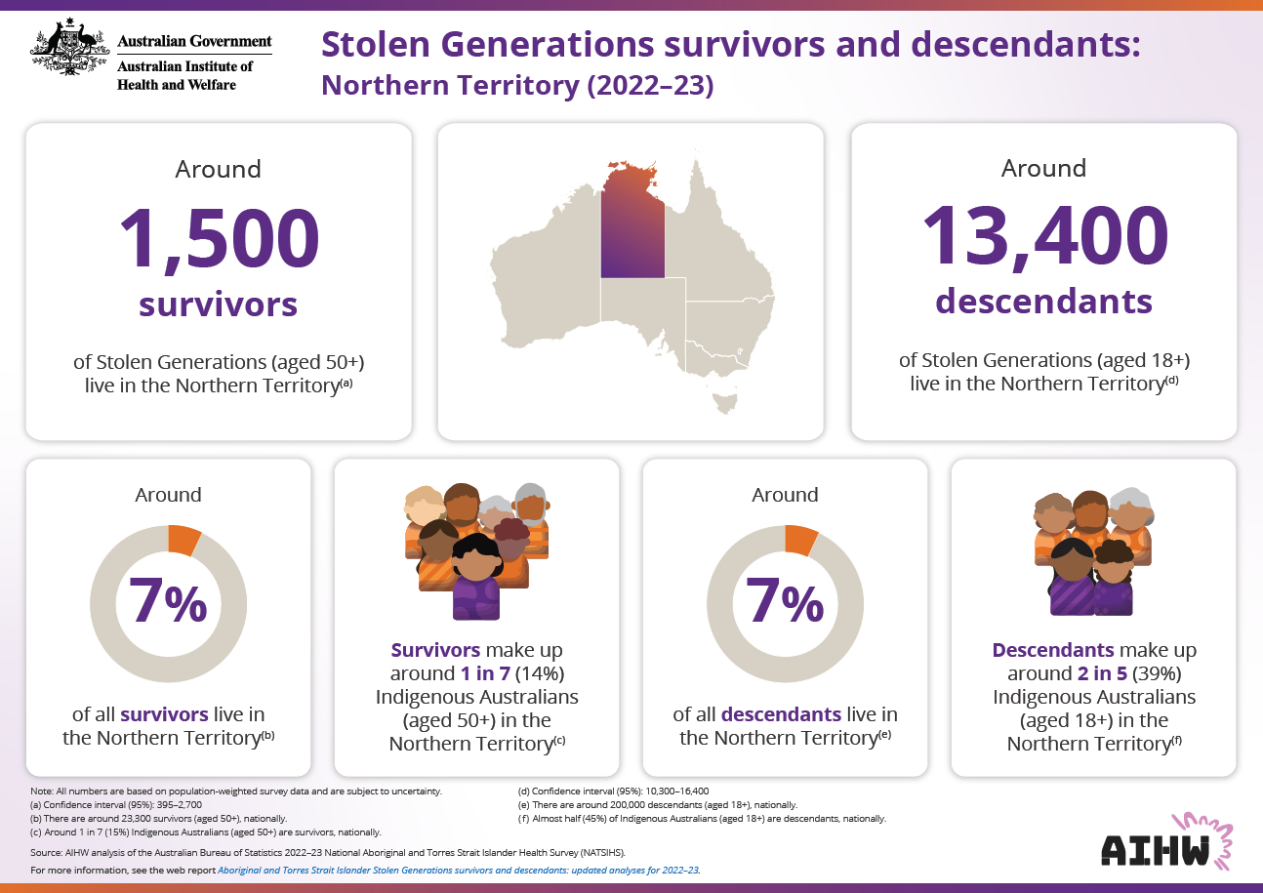
Reports and resources
Downloadable reports
Web report
Fact sheets
Infographics
+ Reading guide & Data tables
Notes:
2× PDF reports
1× report on survivors
1× report on descendants
11× PDF fact sheets
1× summary on survivors
1× summary on descendants
7× state and territory-level infographic
1× matching infographic for Australia
1× interpretation guide
1× web report (hosting both PDF reports and the fact sheets)
1× chapter on survivors (adapted from PDF report)
1× chapter on descendants (adapted from PDF report)
1× downloadable Excel tables file

Slide 19




Enter email address
Enter website URL
Enter Instagram username
Enter LinkedIn username

Slide 20
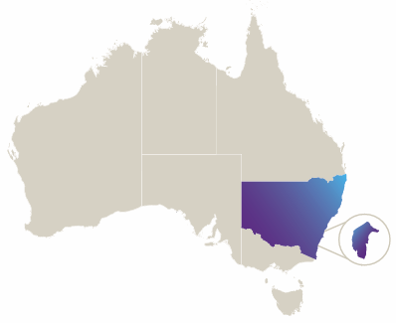
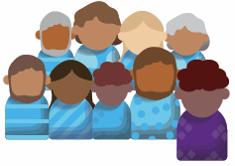
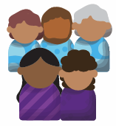
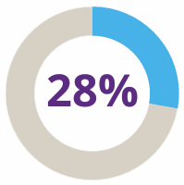
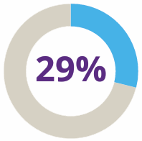
New South Wales and the Australian Capital Territory
Around
6,600
survivors
of Stolen Generations
(aged 50+) live in NSW & the ACT
Around
59,000
descendants
of Stolen Generations
(aged 18+) live in NSW & the ACT
Around
of all survivors live in
NSW & the ACT
Survivors make up
around 1 in 9 (11.5%)
Indigenous Australians
(aged 50+)
in NSW & the ACT
Around
of all descendants live in
NSW & the ACT
Descendants make up
around 2 in 5 (42%)
Indigenous Australians
(aged 18+)
in NSW & the ACT
Notes:
Note: Statistics for the ACT were combined with NSW as they could not be published individually.

Slide 21
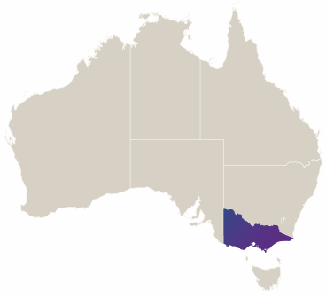
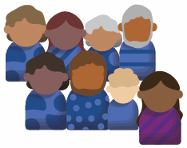
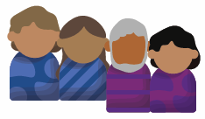
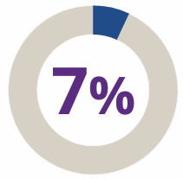
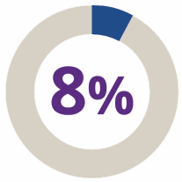
Victoria
Around
1,700
survivors
of Stolen Generations
(aged 50+) live in Victoria
Around
17,000
descendants
of Stolen Generations
(aged 18+) live in Victoria
Around
of all survivors live
in Victoria
Survivors make up
around 1 in 8 (12%)
Indigenous Australians
(aged 50+) in Victoria
Around
of all descendants live
in Victoria
Descendants make up
around half (51%) of
Indigenous Australians
(aged 18+) in Victoria

Slide 22
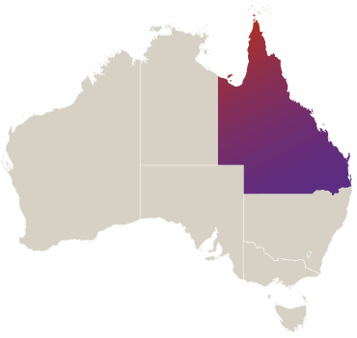
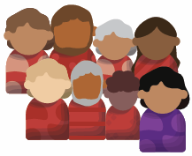
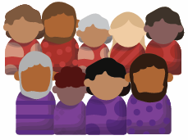
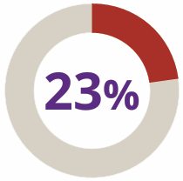
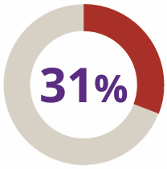
Queensland
Around
5,300
survivors
of Stolen Generations
(aged 50+) live in Queensland
Around
61,400
descendants
of Stolen Generations
(aged 18+) live in Queensland
Around
of all survivors live in
Queensland
Survivors make up
around 1 in 8 (12%)
Indigenous Australians
(aged 50+) in Queensland
Around
of all descendants live in
Queensland
Descendants make up
almost half (44%) of
Indigenous Australians
(aged 18+) in Queensland

Slide 23
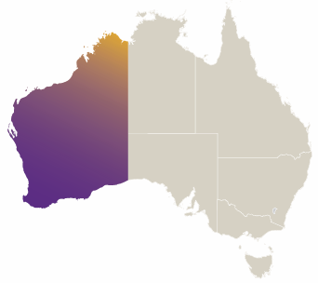
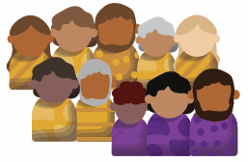
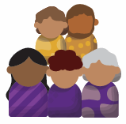
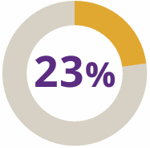
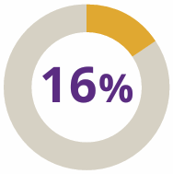
Western Australia
Around
5,400
survivors
of Stolen Generations
(aged 50+) live in Western Australia
Around
31,700
descendants
of Stolen Generations
(aged 18+) live in Western Australia
Around
of all survivors live in
Western Australia
Survivors make up
around 3 in 10 (29%)
Indigenous Australians
(aged 50+)
in Western Australia
Around
of all descendants live in
Western Australia
Descendants make up
around 3 in 5 (58%)
Indigenous Australians
(aged 18+)
in Western Australia

Slide 24
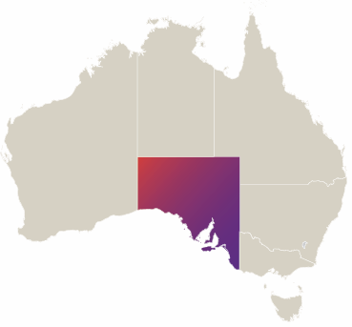
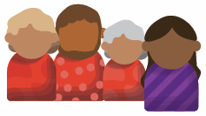
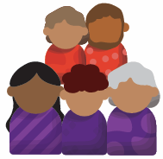
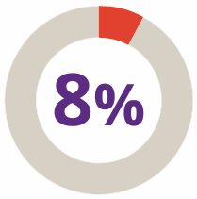
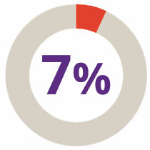
South Australia
Around
1,800
survivors
of Stolen Generations
(aged 50+) live in South Australia
Around
13,500
descendants
of Stolen Generations
(aged 18+) live in South Australia
Around
of all survivors live in
South Australia
Survivors make up
around 1 in 4 (25%)
Indigenous Australians
(aged 50+) in
South Australia
Around
of all descendants live in
South Australia
Descendants make up
around 3 in 5 (57%)
Indigenous Australians
(aged 18+) in
South Australia

Slide 25
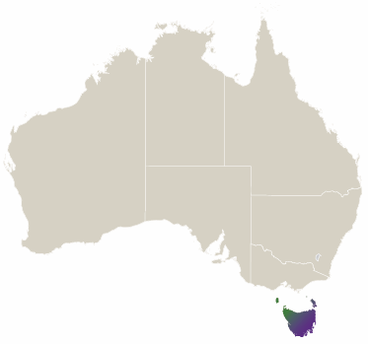
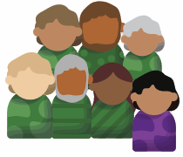
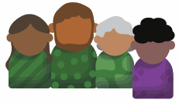
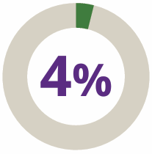
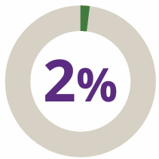
Tasmania
Around
960
survivors
of Stolen Generations
(aged 50+) live in Tasmania
Around
4,100
descendants
of Stolen Generations
(aged 18+) live in Tasmania
Around
of all survivors live in
Tasmania
Survivors make up
around 1 in 7 (14%)
Indigenous Australians
(aged 50+) in Tasmania
Around
of all descendants live in
Tasmania
Descendants make up
around 1 in 4 (24%)
Indigenous Australians
(aged 18+) in Tasmania

Slide 26
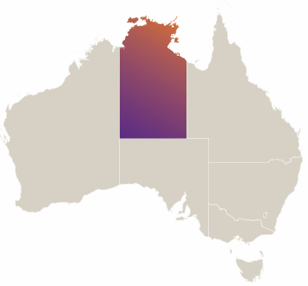
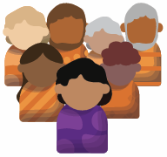
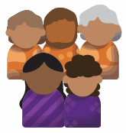
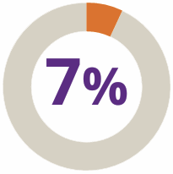
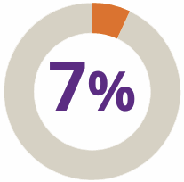
Northern Territory
Around
1,500
survivors
of Stolen Generations (aged 50+)
live in the Northern Territory
Around
13,400
descendants
of Stolen Generations (aged 18+)
live in the Northern Territory
Around
of all survivors live in
the Northern Territory
Survivors make up
around 1 in 7 (14%)
Indigenous Australians
(aged 50+) in the
Northern Territory
Around
of all descendants live in
the Northern Territory
Descendants make up
around 2 in 5 (39%)
Indigenous Australians
(aged 18+) in the
Northern Territory

Slide 27
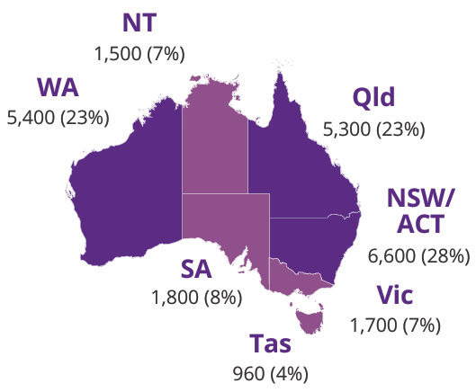



Australia
Around
23,300
survivors
of Stolen Generations
aged 50 and over live in Australia
Around
200,000
descendants
of Stolen Generations
aged 18 and over live in Australia
Around three-quarters (74%) of survivors
live in either NSW/ACT, Qld or WA
Around three-quarters (76%) of descendants
live in either NSW/ACT, Qld or WA
1 in 7
(15%) Indigenous
Australians aged 50 and
over are survivors
Almost half
of Indigenous Australians
aged 18 and over are descendants
Survivors compared
with Indigenous people
not removed were:
Descendants compared
with Indigenous
non-descendants were:
2.7×
as likely to be living with
severe or profound disability
(24%)
1.3×
as likely to be experiencing
high psychological distress
(37%)
1.9×
as likely to be experiencing
high psychological distress
(49%)
1.3×
as likely to have been
diagnosed with a mental
health condition (50%)
1.5×
as likely to have had days
without money for basic
living expenses (past year)
(56%)
1.2×
as likely to have had days
without money for basic
living expenses (past year)
(49%)

